Slide 1
Evidences of
Chemical Changes Foldable

Slide 2
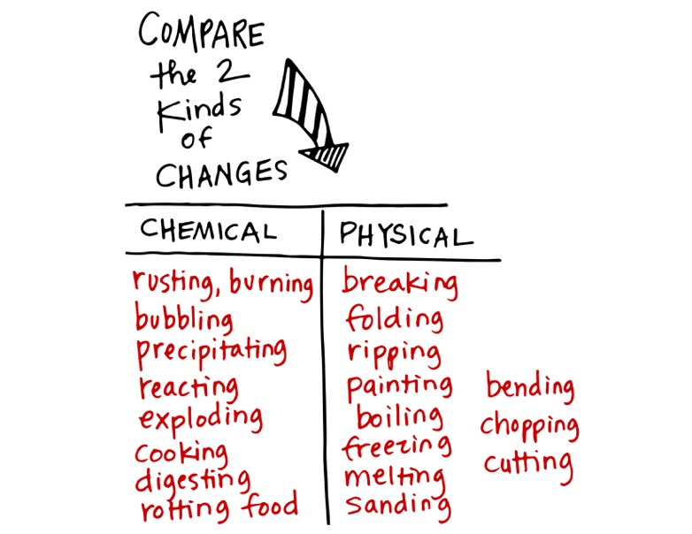

Slide 3
(baking soda is calcium carbonate)

Slide 4
color changes, it can indicate a chemical change.
Ex: steel wool in solution

Slide 5
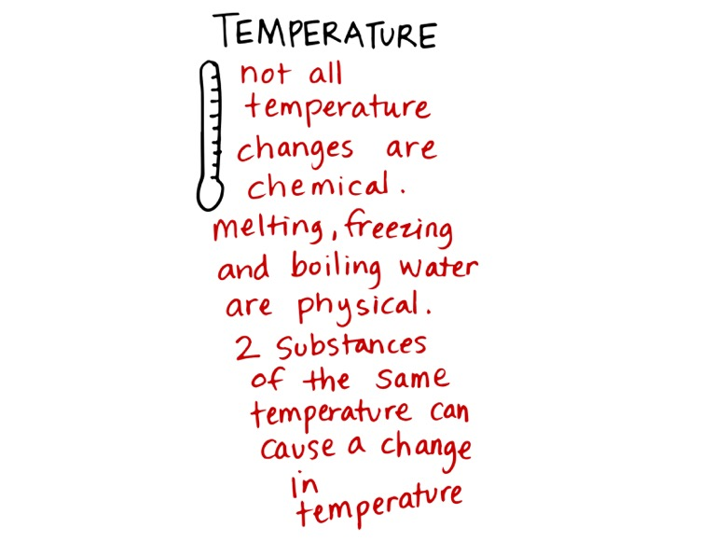
Ex: cream of tartar, baking soda, and water mixed

Slide 6
(glow stick)

Slide 7
Milk and vinegar or spoiled milk

